Slide 1
Identification of lncRNA Diagnostic and Prognostic Biomarkers for Gastric Cancer Using Machine Learning and Integrated Bioinformatics Approach
Fahiz Mohammed PP
Reg. No: 23378013
MSc Bioinformatics
Department of Bioinformatics
Pondicherry University

Slide 2
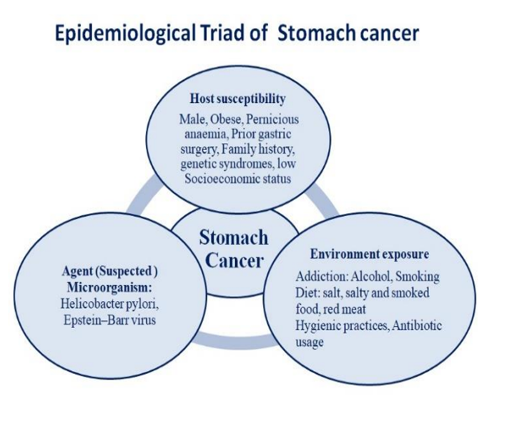
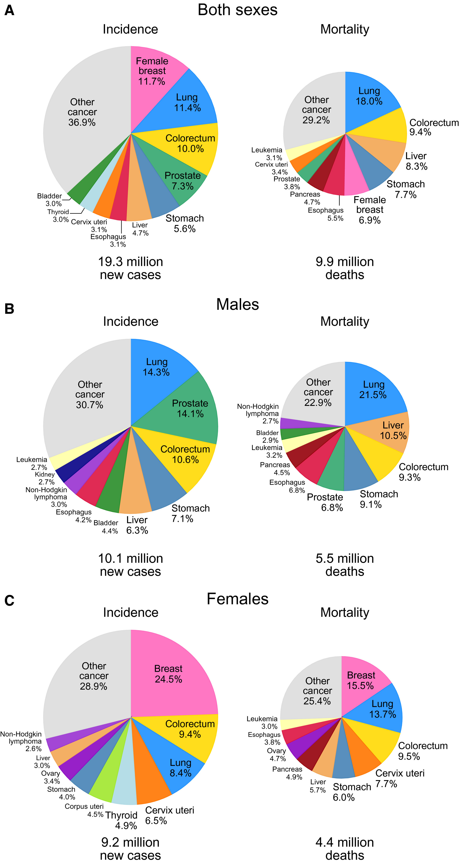
Introduction
Gastric adenocarcinoma (GAC) is the most common stomach cancer, arising from glandular cells in the stomach lining
5th most common cancer worldwide and 4th leading cause of cancer-related deaths
The 5-year survival rate is 31% - Global cancer statistics 2024
2024

Slide 3
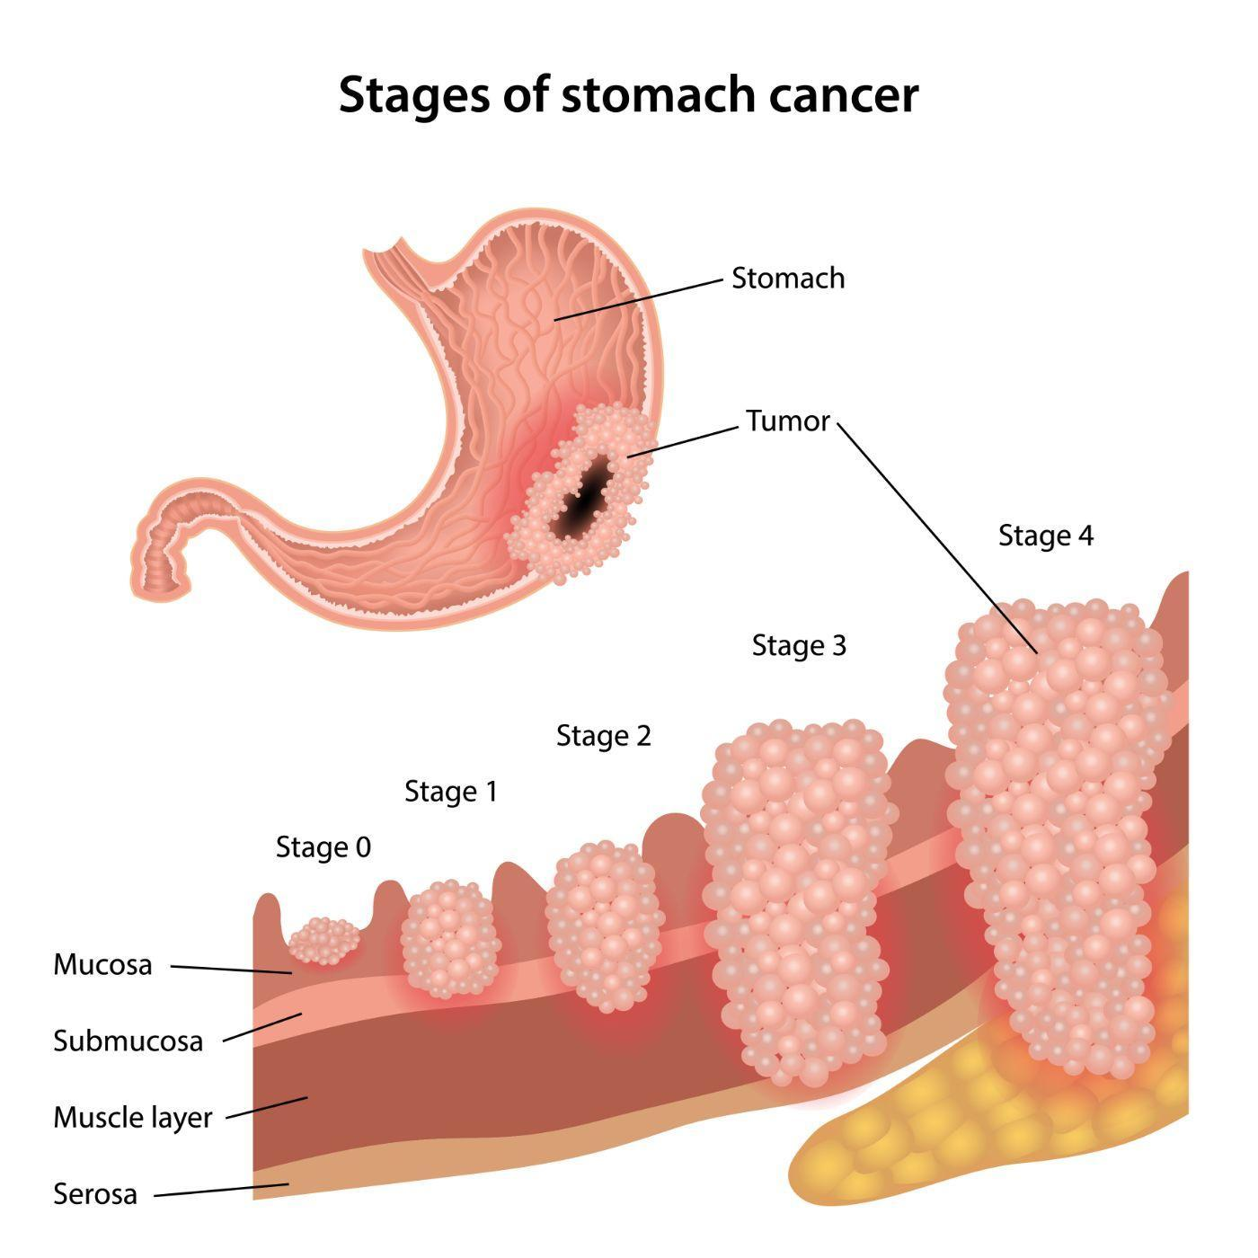
Introduction – cont.
Stage I - outer lining of the stomach.
Stage IV - metastasized to distant organs.
Early detection of gastric cancer significantly improves prognosis, with a survival rate is 80%.
The survival rate for patients diagnosed at the metastatic stage is poor.
Traditional gene-based molecular markers have often failed to effectively predict GC during its early stages.
Non-coding RNAS (ncRNAs), particularly long non-coding RNAS (lncRNAs), play a crucial role in cancer development and have emerged as important predictive biomarkers.
lncRNAs represent a promising class of non-invasive diagnostic markers for the early detection of GC.

Slide 4
Objectives
Primary Objective:
To identify long non-coding RNA (lncRNA) candidates as diagnostic and prognostic biomarkers for the early detection of gastric cancer.
Sub-objectives:
To determine differentially expressed lncRNAs using publicly available transcriptomic datasets (TCGA-STAD and PRJNA435914).
To apply feature selection techniques for identifying the most informative lncRNAs associated with GC diagnosis.
To evaluate the diagnostic and prognostic performance of the selected lncRNA candidates using ML methods.

Slide 5
Methodology
TCGA-STAD
(R-TCGAbiolinks package)
ENA(PRJNA435914)
Quality Check (MultiQC)
Trimming(Trimmomatic)
Alignment(HISAT2)
Count Matrix(FeatureCounts)
Linux Terminal
Filtering lncRNAs
Filtering lncRNA
Differentially Expressed lncRNAs(DESeq2)
Differentially Expressed lncRNAs (DESeq2)
Up-regulated
Down-regulated
Up-regulated
Down-regulated
Common Up-regulated
Common Down-regulated
lncRNA - Target Interaction
(lncTarD 2.0,
Cytoscape)
Batch Correction
(Combat)
Common Differentially Expressed lncRNAs
Diagnostic Performance Prediction
Survival Analysis
(KM-plot)
Feature Importance
(Boruta)
ROC
Curve
Feature Selection
(Elastic Net)

Slide 6
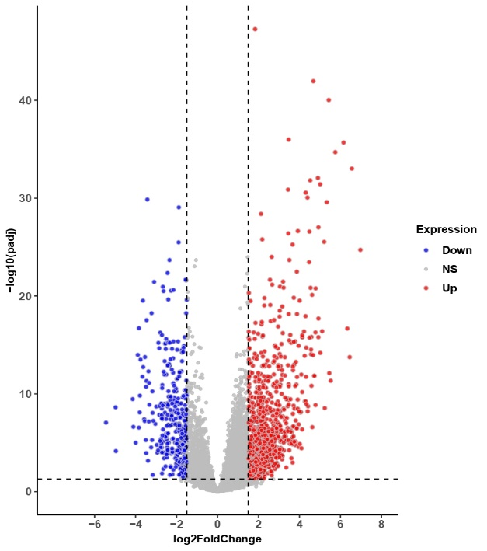
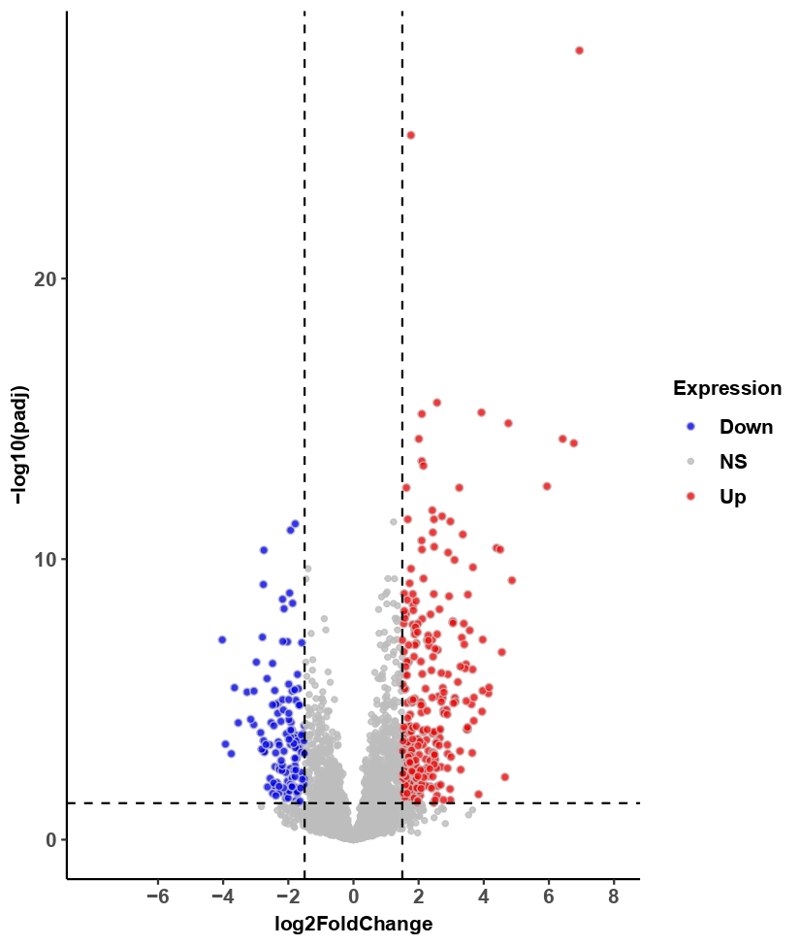
Results – DElncRNAs identification
TCGA Data Analysis:
ENA Data Analysis:
log2FC > ±1.5 and padj < 0.05
Total samples: 448 (36 - normal 412 -tumor)
Total lncRNAs : 1547
Upregulated: 1175
Downregulated: 372
Total samples: 68 (34 – normal & 34 -tumour)
Total lncRNAs : 410
Upregulated: 277
Downregulated: 133

Slide 7
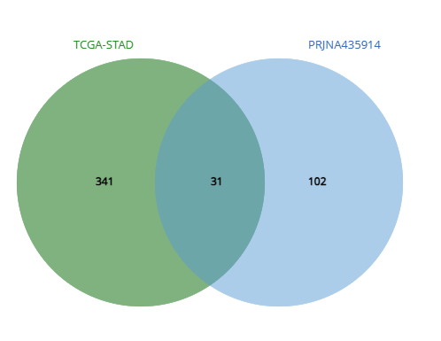

Common lncRNAs
Down-regulated
Up-regulated
Total lncRNAs: 145
Upregulated: 114
Downregulated: 31

Slide 8
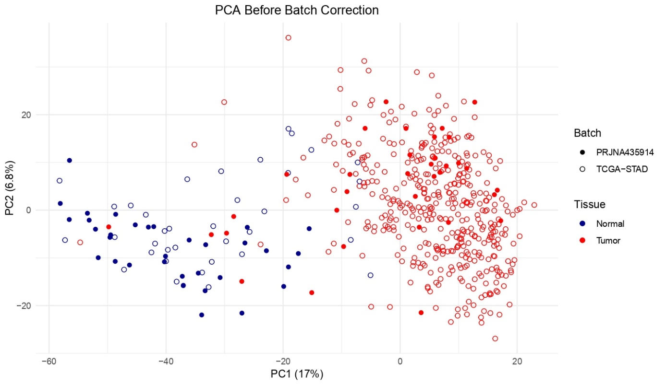
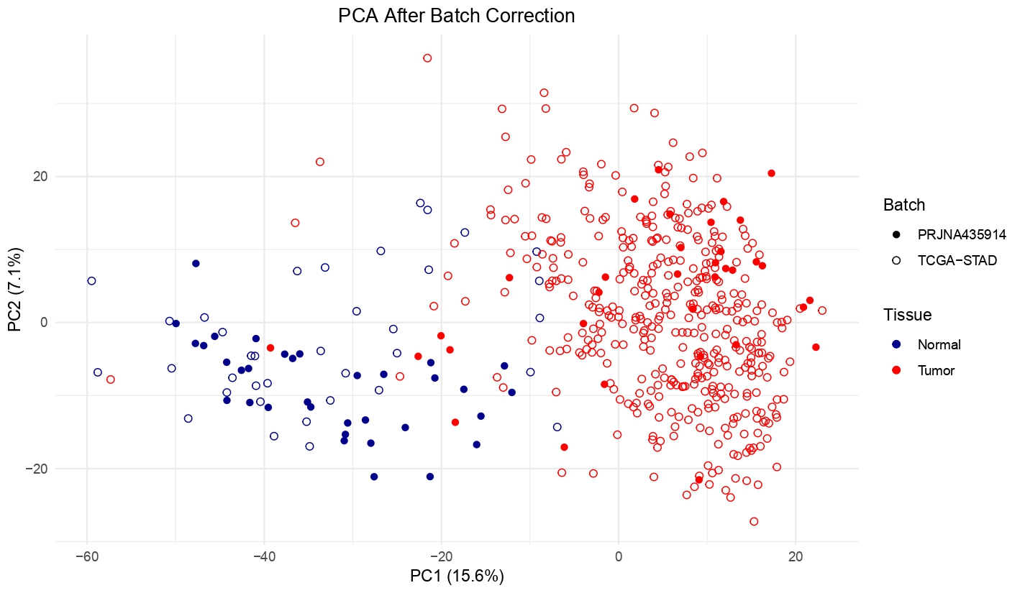
Batch Correction – Combat R package
To reduce the variation between different batch samples
Total samples: 516
Normal – 70
Tumour - 446

Slide 9
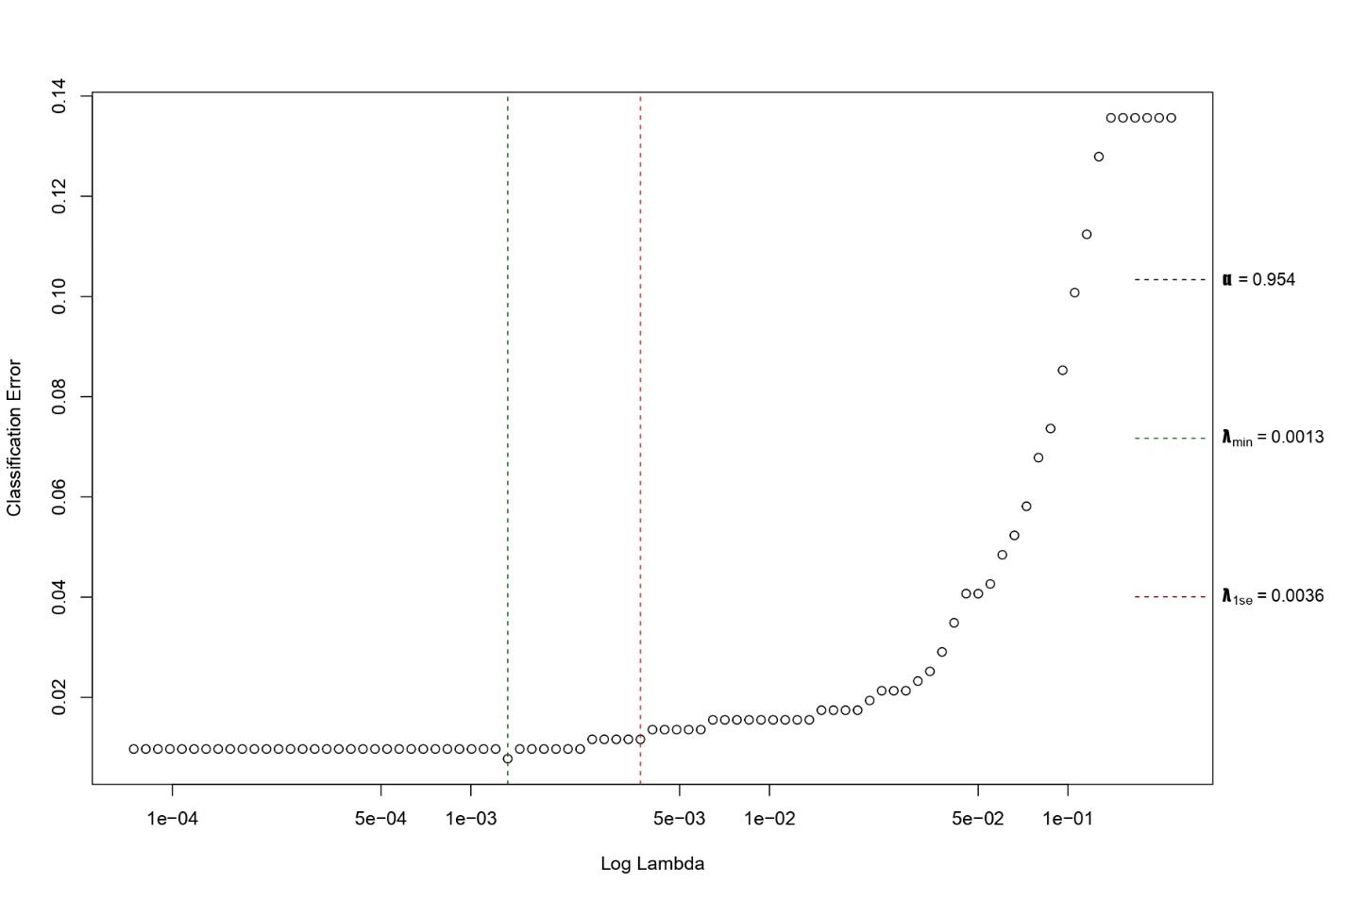
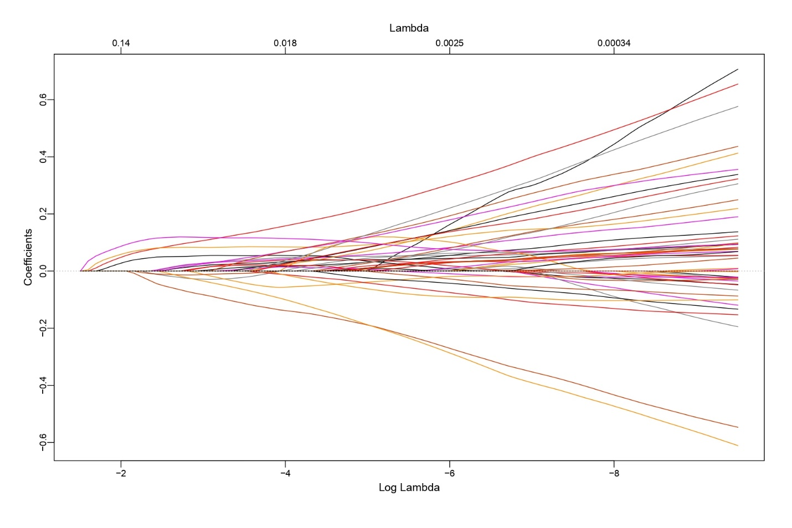
Feature Selection – Elastic net
To select the optimal features associated with the diagnosis of GC
L1 and L2 regularization
Optimal alpha: 0.954
Total 37 features were selected

Slide 10
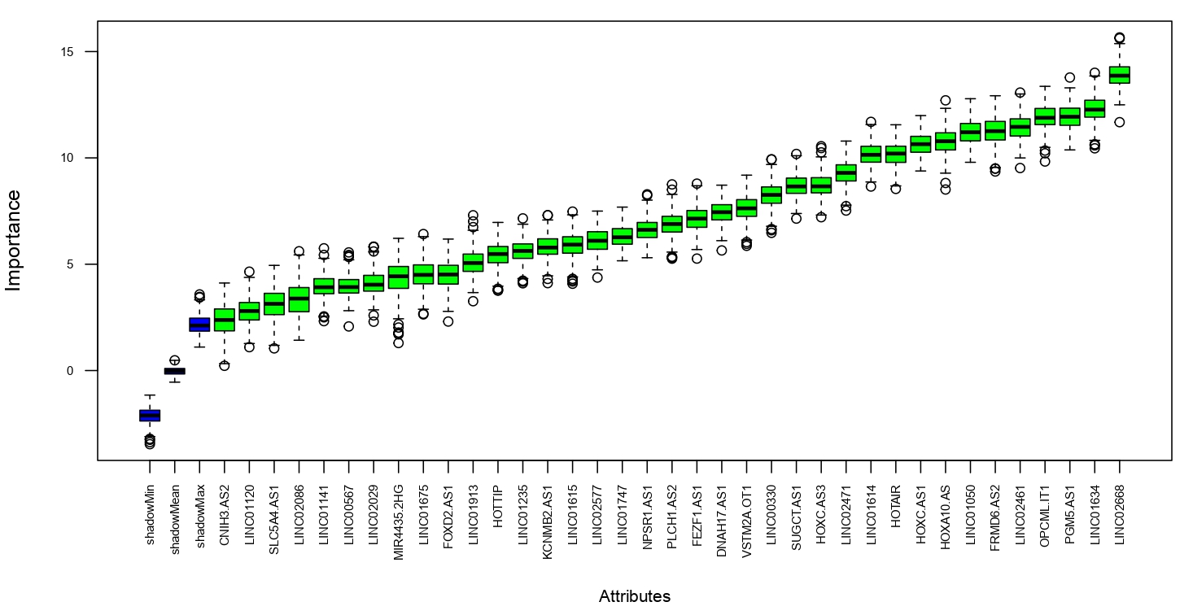
Feature importance – Boruta
Boruta – Random Forest
500 repetitions
37 features are important

Slide 11
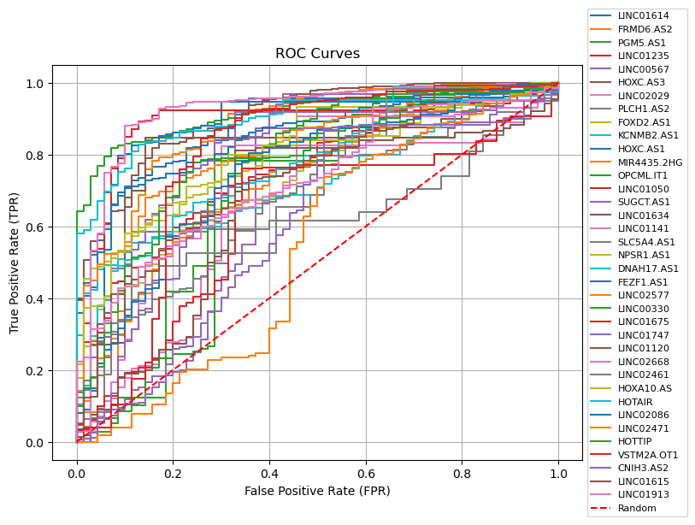
Diagnostic performance prediction - ROC
Features | AUC values
LINC01614 | 0.8793
FRMD6.AS2 | 0.873203
PGM5.AS1 | 0.930281
LINC01235 | 0.76189
LINC00567 | 0.641991
HOXC.AS3 | 0.828088
LINC02029 | 0.646732
PLCH1.AS2 | 0.556537
FOXD2.AS1 | 0.748348
KCNMB2.AS1 | 0.733405
HOXC.AS1 | 0.878449
MIR4435.2HG | 0.72803
OPCML.IT1 | 0.649567
LINC01050 | 0.887186
SUGCT.AS1 | 0.830498
LINC01634 | 0.872994
LINC01141 | 0.716984
SLC5A4.AS1 | 0.685411
NPSR1.AS1 | 0.80982
DNAH17.AS1 | 0.778795
FEZF1.AS1 | 0.852973
LINC02577 | 0.830707
LINC00330 | 0.692258
LINC01675 | 0.608817
LINC01747 | 0.748001
LINC01120 | 0.644531
LINC02668 | 0.927569
LINC02461 | 0.645253
HOXA10.AS | 0.802742
HOTAIR | 0.894957
LINC02086 | 0.753377
LINC02471 | 0.555159
HOTTIP | 0.790137
VSTM2A.OT1 | 0.772698
CNIH3.AS2 | 0.601739
LINC01615 | 0.752576
LINC01913 | 0.731775

Slide 12
Diagnostic performance prediction - ROC
AUC > 0.85 were selected
9 lncRNAs were identified as diagnostic marker candidates
lncRNA | PRJNA435914 |  | TCGA-STAD |  | AUC Value
 | Log2FC | Regulation | Log2FC | Regulation
LINC01614 | 6.94 | Up | 5.01 | Up | 0.87
FRMD6-AS2 | -2.48 | Down | -1.99 | Down | 0.87
PGM5-AS1 | -2.18 | Down | -3.37 | Down | 0.93
HOXC-AS1 | 4.76 | Up | 3.66 | Up | 0.87
LINC01050 | 4.87 | Up | 5.21 | Up | 0.88
LINC01634 | -2.38 | Down | -2.8 | Down | 0.87
FEZF1-AS1 | 2.43 | Up | 4.53 | Up | 0.85
LINC02668 | -1.88 | Down | -2.6 | Down | 0.92
HOTAIR | 4.5 | Up | 5.43 | Up | 0.89

Slide 13
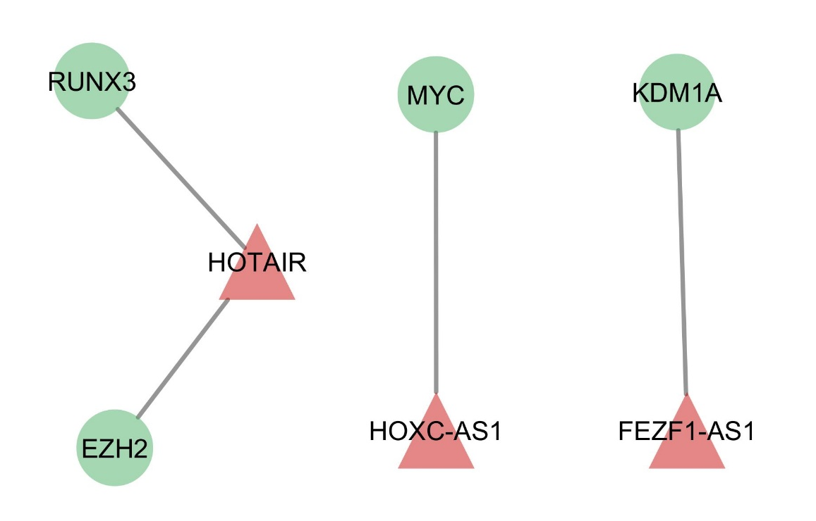
LncRNA-Target interaction
LncTarD 2.0 database - lncRNA–target regulations in human diseases
LncRNA-Target mRNA integration in GC were collected.
LINC01614, FRMD6-AS2, PGM5-AS1, LINC01050, LINC01634, LINC02668 gene interaction were not reported
KDM1A, MYC, RUNX3 and EZH2 are reported as oncogenes and involving in GC progression
Disease | Lnc Regulator | Target | Regulatory Mechanism
Gastric cancer | FEZF1-AS1 | KDM1A | interact with protein
Gastric cancer | HOXC-AS1 | MYC | interact with protein
Gastric cancer | HOTAIR | RUNX3 | interact with protein
Gastric cancer | HOTAIR | EZH2 | interact with protein
Target mRNA
LncRNA regulator

Slide 14
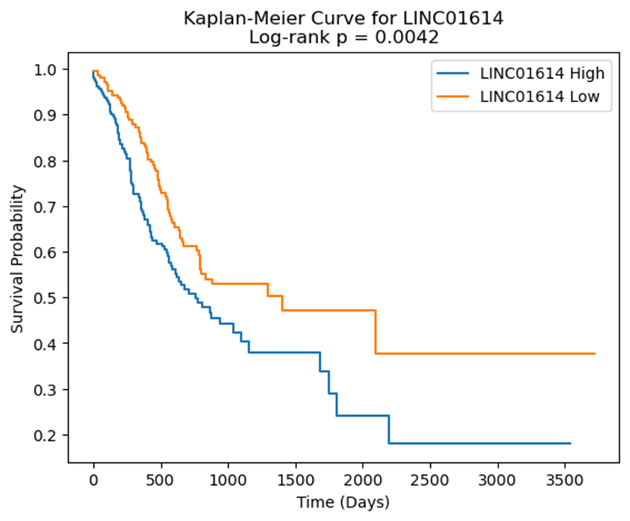
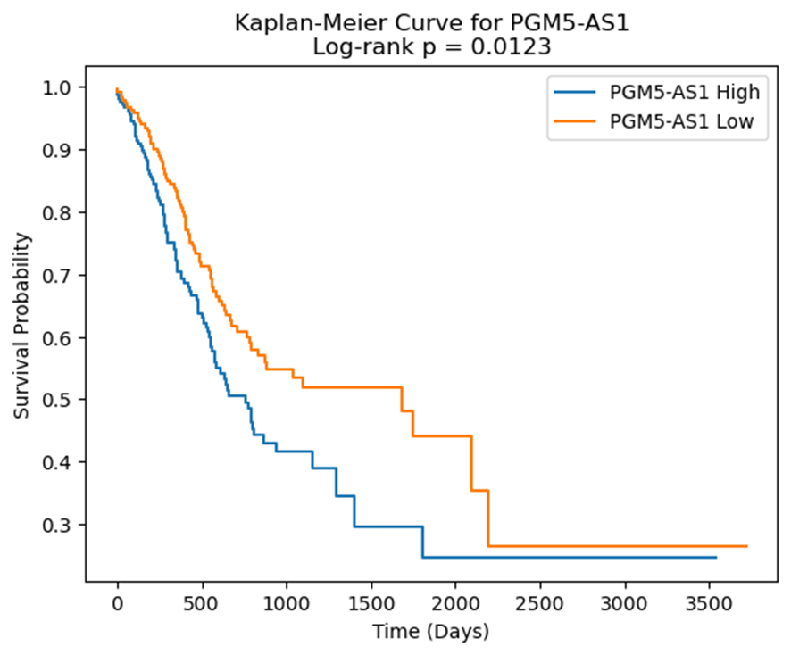
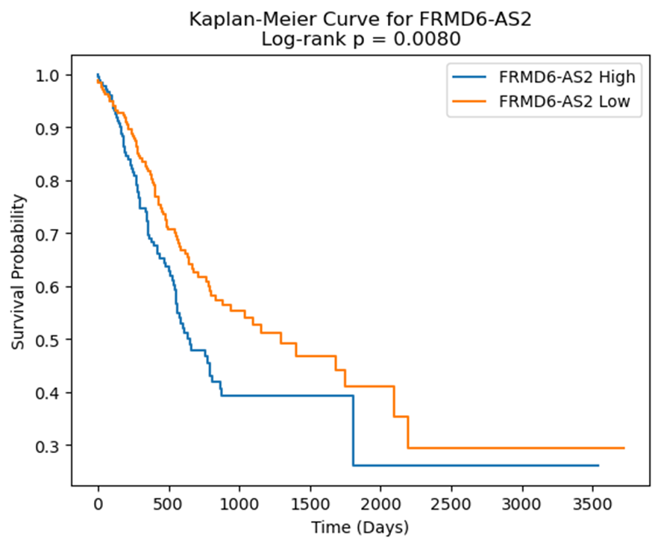
Survival Analysis
KM plot python Package
P-value < 0.05
LINC01614, PGM5-AS1 and FRMD6-AS2 are highly associated with poor survival of GC
These could be the potential therapeutic targets for GC

Slide 15
Summary and Conclusion
A total of 145 common lncRNAs were identified between the TCGA-STAD dataset and PRJNA435914
37 lncRNAs were found to be strongly associated with GC through variable selection methods.
Diagnostic evaluation using ROC curve analysis revealed that 9 of these lncRNAs exhibited high predictive accuracy (AUC > 0.85).
FEZF1-AS, HOXC-AS1 and HOTAIR lncRNAs interacting with KDM1A, MYC, RUNX3 and EZH2 are reported as oncogenes and involving in GC progression
The lncRNAs LINC01614, FRMD6-AS2, PGM5-AS1, OXC-AS1, LINC01050, LINC01634, FEZF1-AS1, LINC02668, and HOTAIR emerged as promising diagnostic biomarker candidates for GC.
LINC01614, PGM5-AS1 and FRMD6-AS2 are highly associated with poor survival and it could be the potential therapeutic targets for GC

Slide 16
Reference
H. Sung et al., “Global Cancer Statistics 2020: GLOBOCAN Estimates of Incidence and Mortality Worldwide for 36 Cancers in 185 Countries,” CA: A Cancer Journal for Clinicians, vol. 71, no. 3, pp. 209–249, 2021, doi: 10.3322/caac.21660.
P. Correa, “Gastric Cancer: Overview,” Gastroenterology clinics of North America, vol. 42, no. 2, p. 211, Feb. 2013, doi: 10.1016/j.gtc.2013.01.002.
U. Adiga, J. Brahmaiah, A. J. Augustine, R. Ramakrishna, T. Rai, and S. Vasishta, “Computational and Bioinformatics Analysis of Gallbladder Cancer Gene Expression Profiles,” Biomedical and Biotechnology Research Journal (BBRJ), vol. 9, no. 1, p. 78, Mar. 2025, doi: 10.4103/bbrj.bbrj_392_24.
J. N. Weinstein et al., “The Cancer Genome Atlas Pan-Cancer analysis project,” Nat Genet, vol. 45, no. 10, pp. 1113–1120, Oct. 2013, doi: 10.1038/ng.2764.
“Moderated estimation of fold change and dispersion for RNA-seq data with DESeq2 | Genome Biology | Full Text.” Accessed: Apr. 30, 2025. [Online]. Available: https://genomebiology.biomedcentral.com/articles/10.1186/s13059-014-0550-8
J. T. Leek, W. E. Johnson, H. S. Parker, A. E. Jaffe, and J. D. Storey, “The sva package for removing batch effects and other unwanted variation in high-throughput experiments,” Bioinformatics, vol. 28, no. 6, pp. 882–883, Mar. 2012, doi: 10.1093/bioinformatics/bts034.
G. Manikandan, B. Pragadeesh, V. Manojkumar, A. L. Karthikeyan, R. Manikandan, and A. H. Gandomi, “Classification models combined with Boruta feature selection for heart disease prediction,” Informatics in Medicine Unlocked, vol. 44, p. 101442, Jan. 2024, doi: 10.1016/j.imu.2023.101442
T. Fawcett, “An introduction to ROC analysis,” Pattern Recognition Letters, vol. 27, no. 8, pp. 861–874, Jun. 2006, doi: 10.1016/j.patrec.2005.10.010.
H. Zhao et al., “LncTarD 2.0: an updated comprehensive database for experimentally-supported functional lncRNA–target regulations in human

Slide 17
THANK YOU..!

